Slide 1


Towards EEG diagnosis of ADHD
Tutor : Laura Igual
Ainhoa Hermoso, Andrés Rojas, Carles Panadès, Cecilia Girón, Mirta Rodriguez
Notes:
Chicos, los acentos...no me salen en drive!! Carles, si puedes!!!

Slide 2
Outline
Introduction to ADHD and EEG signals
Understanding our data: Visualization of A,B,C experiments
Classification of ADHD and healthy subjects: Clusterization
Towards ADHD diagnosis using EEG: Supervised Learning
Towards ADHD diagnosis using EEG: Visualization of healthy/ADHD subjects
Towards ADHD diagnosis using EEG: Correlation graph analysis
Conclusions

Slide 3
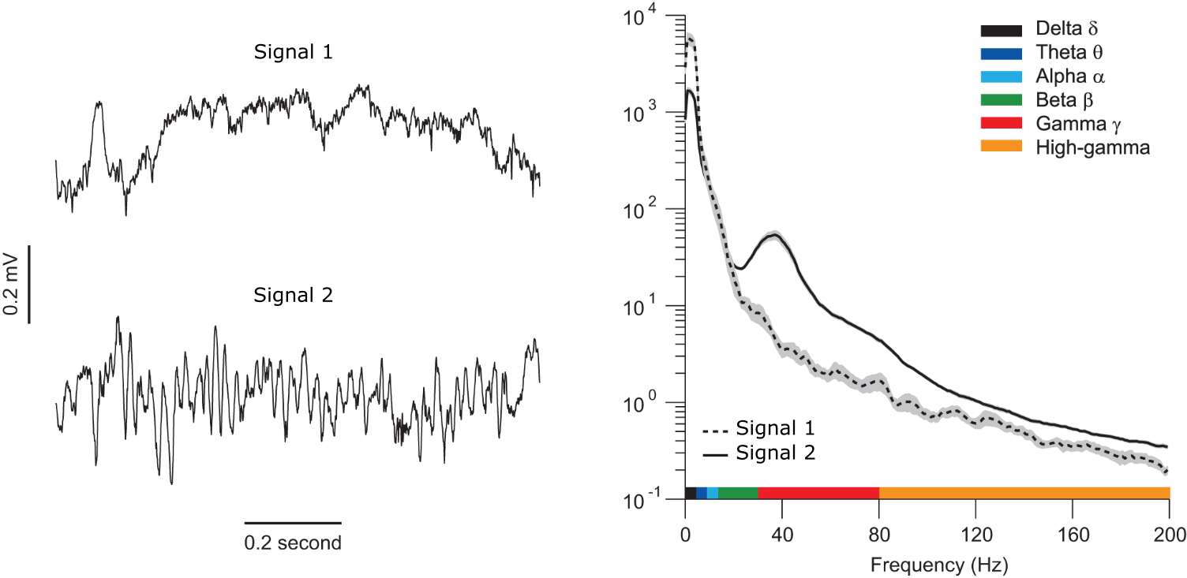
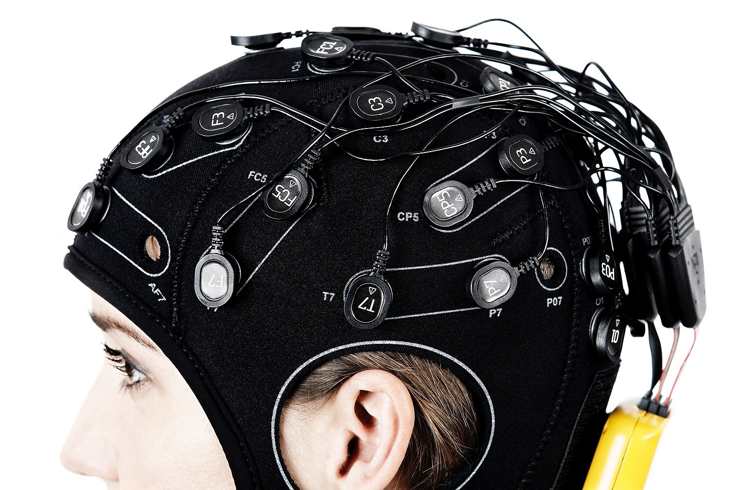
Introduction
Aim: “Make a quantitative analysis of the EEG data of several ADHD and non-ADHD subjects and develop a mathematical tool that classifies them in healthy or putative ADHD subjects”
Enobio

Slide 4
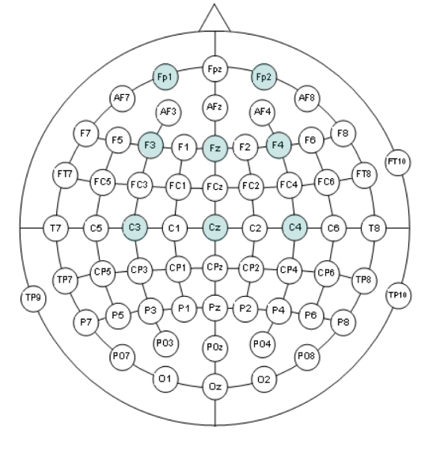
Introduction: Data
8 electrodes and 7 bands (Theta2+Alpha, Theta, Alpha, Global Beta, Top Beta, Bottom Beta and Gamma)
Data: Totally-anonymized data of group of ADHD subjects (n= 335) and healthy subjects.
Power
Power ratio between two unknown bands
3 different experiments (unknown which is A,B or C):
Attentional task
Close eyes resting state task
Open eyes resting state task

Slide 5
Understanding our data: Visualization

Slide 6
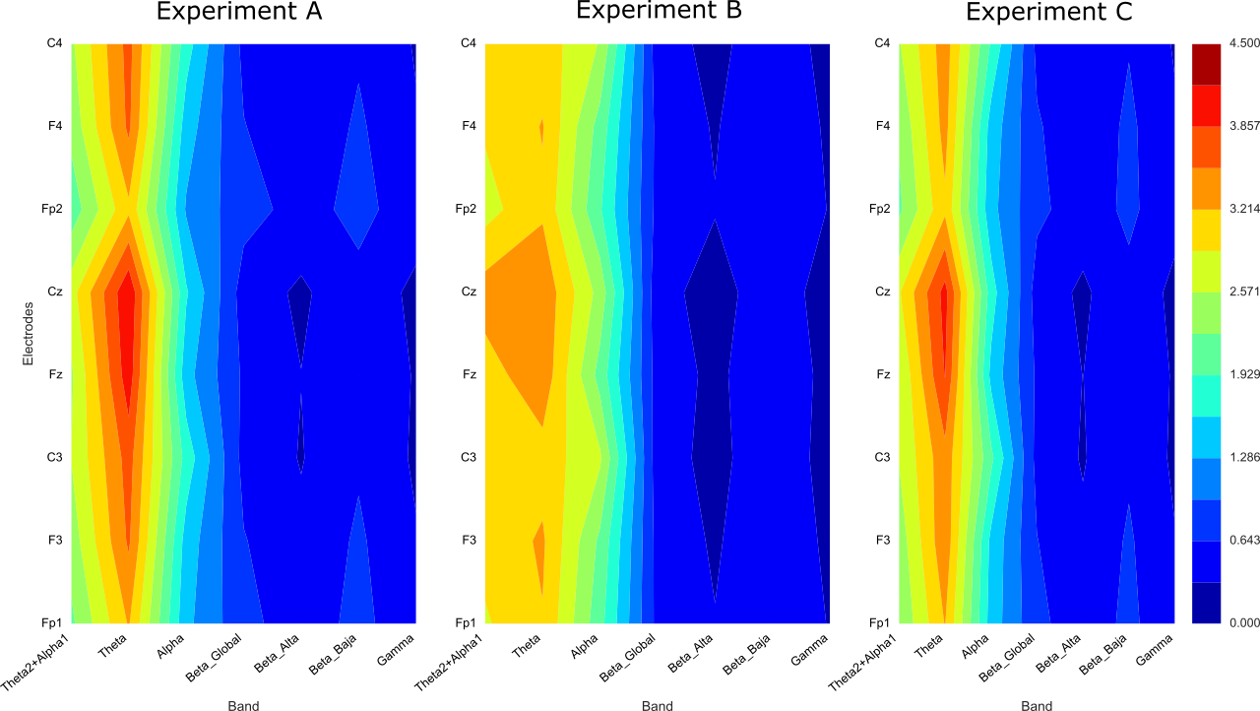
General Visualization
Attentional Task
Close eyes resting Task
Open eyes resting Task

Slide 7
Classification of ADHD and healthy subjects: Clusterization

Slide 8
Unsupervised Learning: Clustering
Classification of ADHD and healthy subjects Cluster Analysis

Slide 9
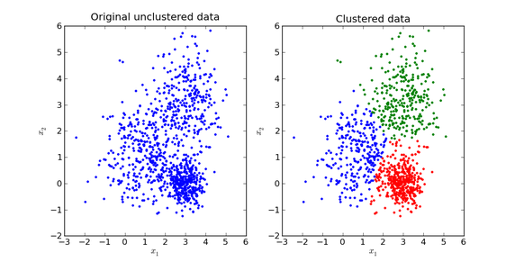
Unsupervised Learning: Clustering
Classification of patients in ADHD and no-ADHD Cluster Analysis
Notes:
Estos no son nuestros datos...los ponemos?????? Es solo para intro, verdad?

Slide 10
Unsupervised Learning: Clustering
Classification of patients in ADHD and no-ADHD Cluster Analysis
Many methods for clustering, the following have been used
K-means
Gaussian Mixture Models
Hierarchical
Spectral
Self-organizing Map

Slide 11
Unsupervised Learning: Clustering
Classification of patients in ADHD and no-ADHD Cluster Analysis
Many methods for clustering, the following have been used
K-means
Gaussian Mixture Models
Hierarchical
Spectral
Self-organizing Map

Slide 12
K-means Clustering
Clusters data by trying to separate samples in groups of equal variance

Slide 13
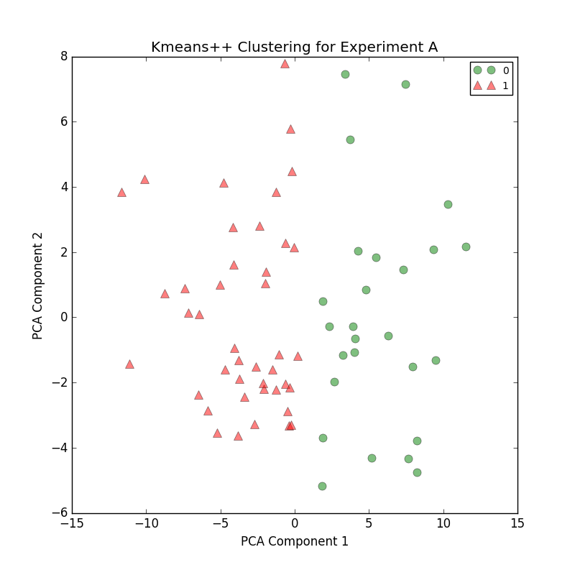
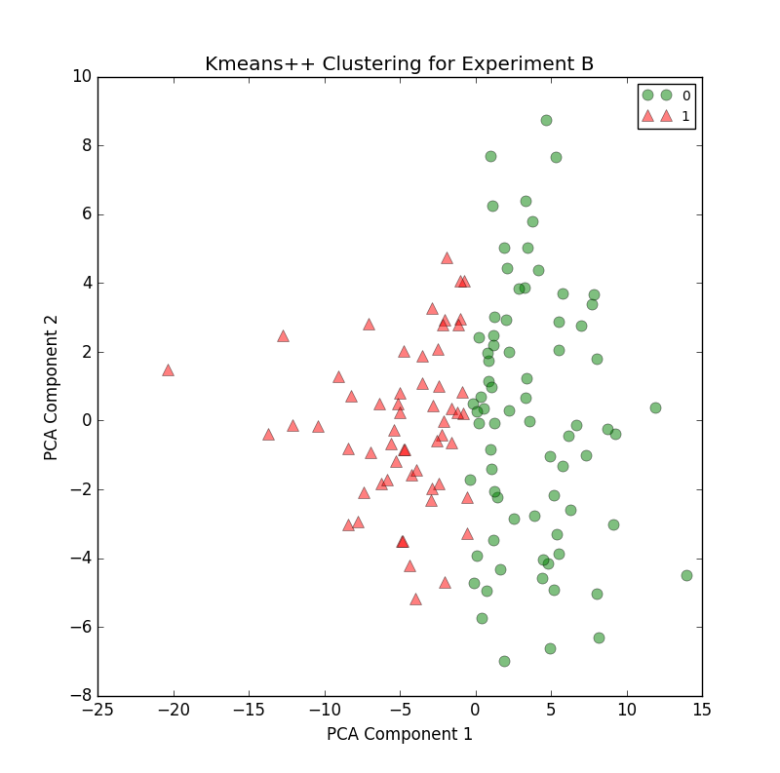
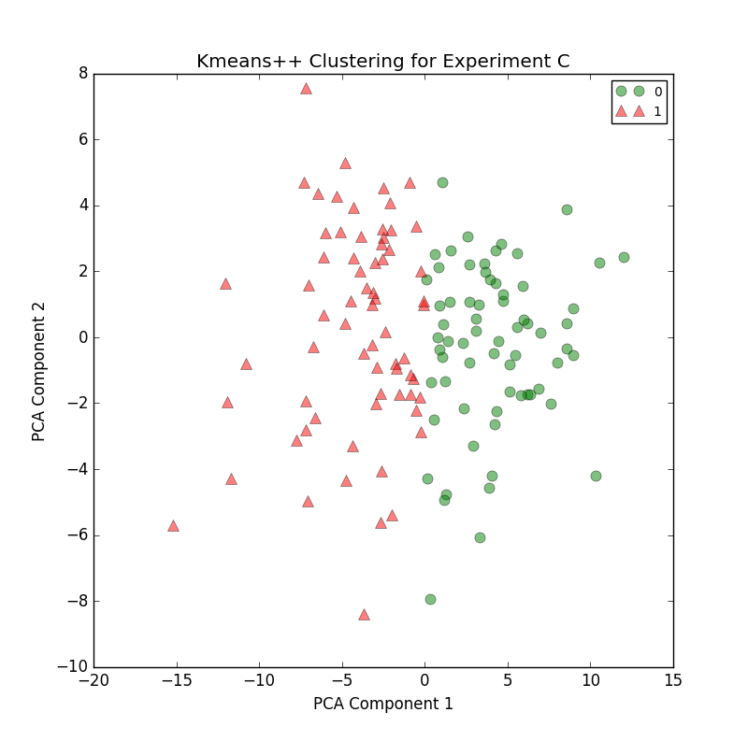
K-means Clustering
Clusters data by trying to separate samples in groups of equal variance

Slide 14
K-means Clustering
Clusters data by trying to separate samples in groups of equal variance
Silhouette values: 0.27, 0.23 and 0.22

Slide 15
K-means Clustering
Clusters data by trying to separate samples in groups of equal variance
Predisposition to look for clusters of similar size

Slide 16
Hierarchical Clustering
Algorithms build nested clusters by merging points and clusters successively

Slide 17
(Ward) Hierarchical Clustering
Minimizes the sum of squared differences within all clusters, similar to the k-means method tackled with a hierarchical approach.

Slide 18

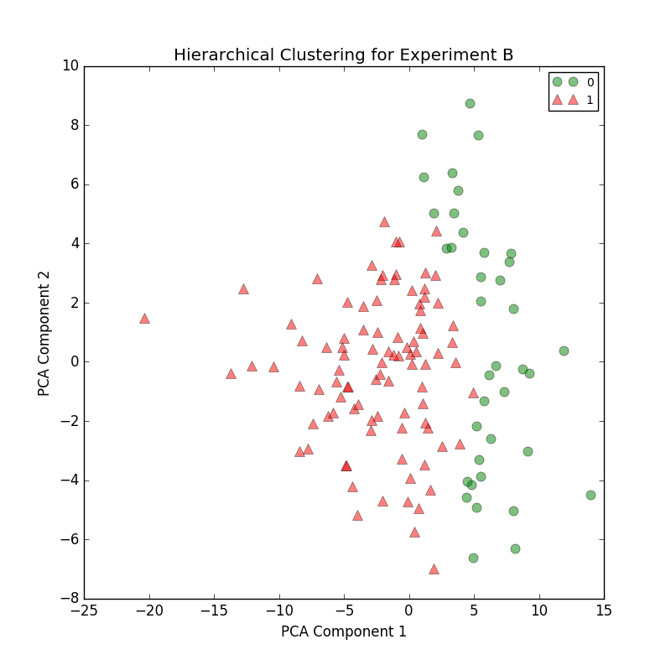
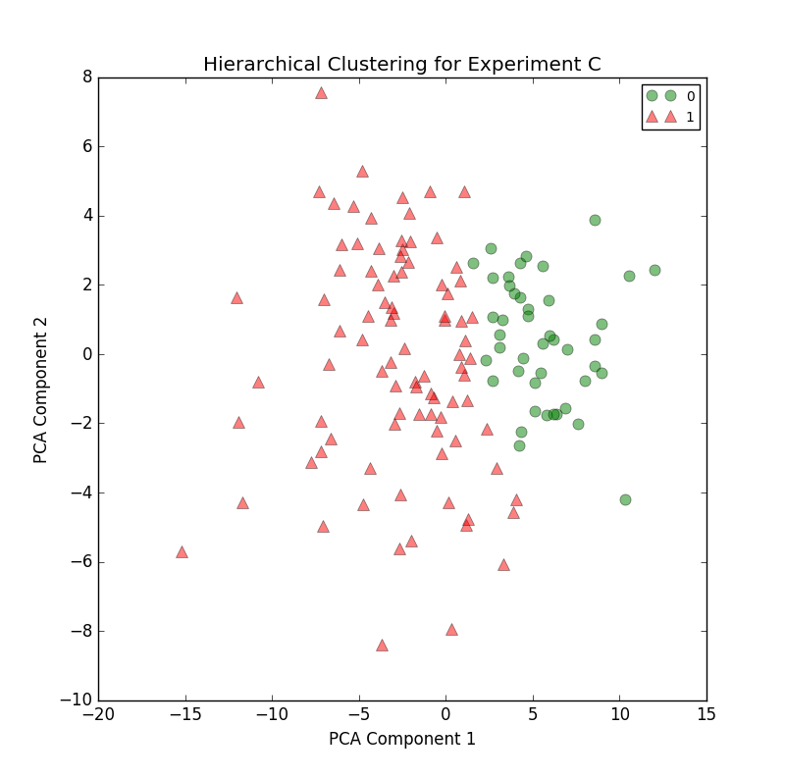
(Ward) Hierarchical Clustering
Minimizes the sum of squared differences within all clusters, similar to the k-means method tackled with a hierarchical approach

Slide 19
(Ward) Hierarchical Clustering
Minimizes the sum of squared differences within all clusters, similar to the k-means method tackled with a hierarchical approach
Classification of patients in two categories after being grouped one by one

Slide 20
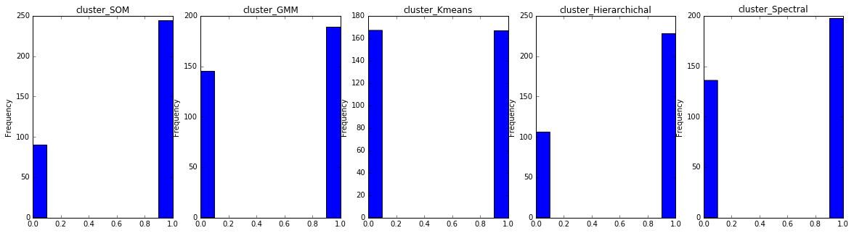
Comparing Clusterings

Slide 21
Comparing Clusterings
Uneven cluster size!

Slide 22
Comparing Clusterings
Easy to discern similarity of patients and sequential grouping (Dendrogram)

Slide 23
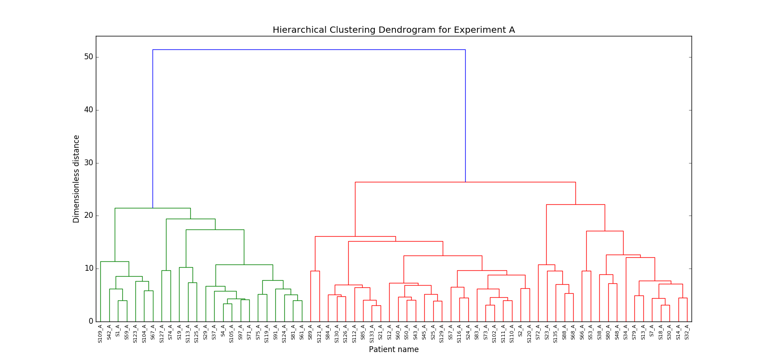
Dendrogram: Experiment A

Slide 24
Towards EEG diagnosis of ADHD:
Supervised Learning

Slide 25
Supervised Learning for diagnosis prediction
ADHD and healthy subjects labelled with results of hierarchical clustering
Motivation
The first motivation was to provide a predictive model of ADHD patients that could be tested as a case study.
The second, to shed light on the finding of the most relevant features for detecting Biomarkers of ADHD disease and to support the findings in the correlations of our data analysis.

Slide 26
Supervised Learning
Algorithms used for Supervised Learning:
Random Forest
Support Vector Machines
Metrics used for measuring performance
Precision
Recall
F1-measure
K-fold leave one out

Slide 27
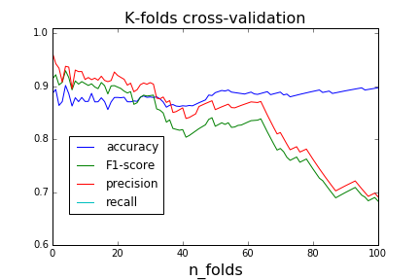
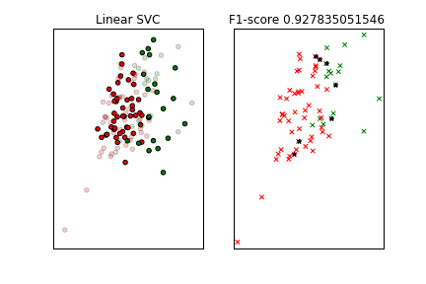
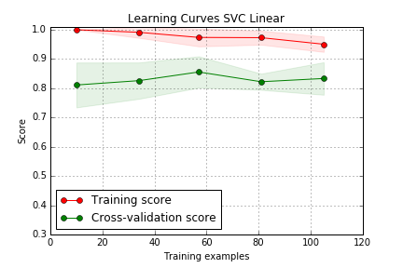
Support Vector Classifier-experiment B

Slide 28
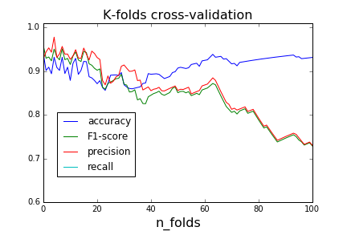
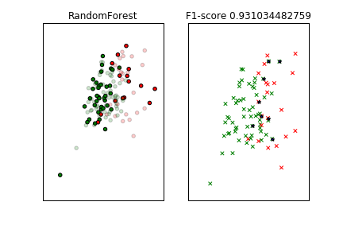
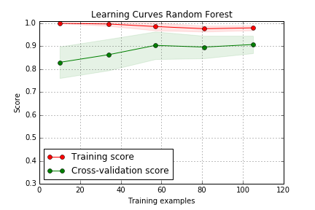
Random Forest Classifier-experiment B

Slide 29
Towards EEG diagnosis of ADHD: Visualization

Slide 30
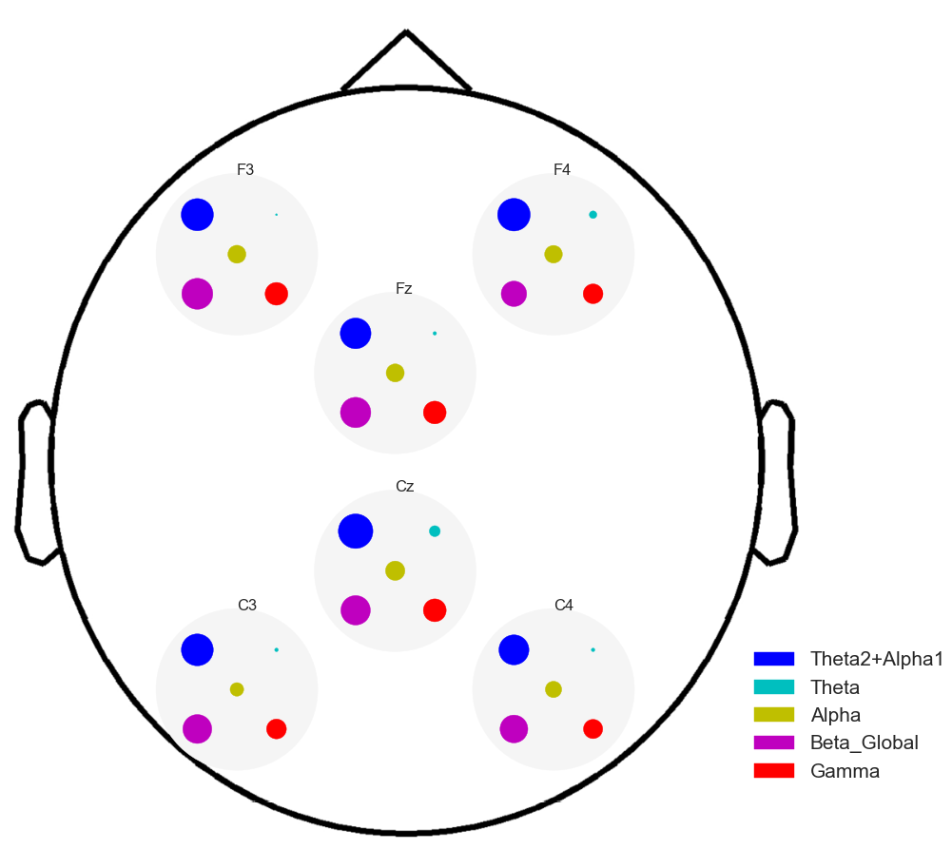
Visualization: Which features have more differences? (I)
Absolute normalized difference - Experiment B

Slide 31
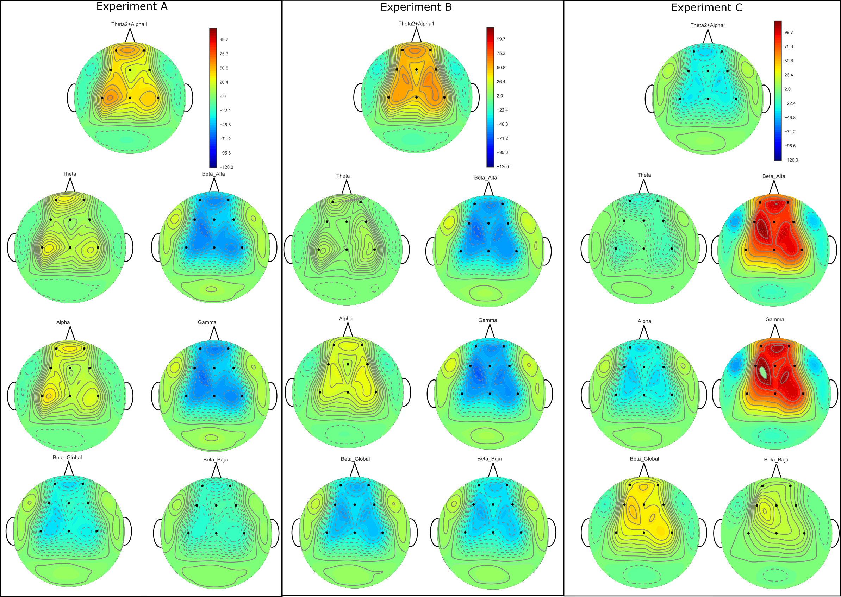
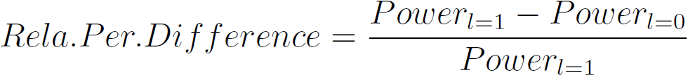
Visualization: Which features have more differences? (II)
Relative percentage difference:
Biggest increase: Theta2+Alpha1
Biggest decrease: Beta_Alta and Gamma
A & B consistent with previous literature

Slide 32
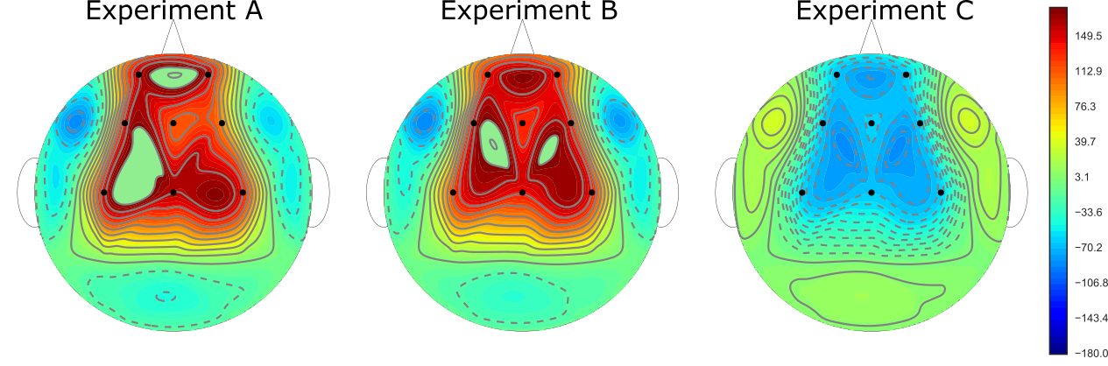
Visualization: Which features have more differences? (II)
Band Ratio Relative percentage difference:
The more relevant increase or decrease happens in the F3, C3 and Cz electrodes.

Slide 33
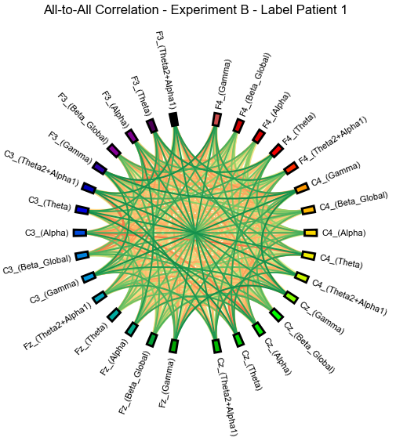
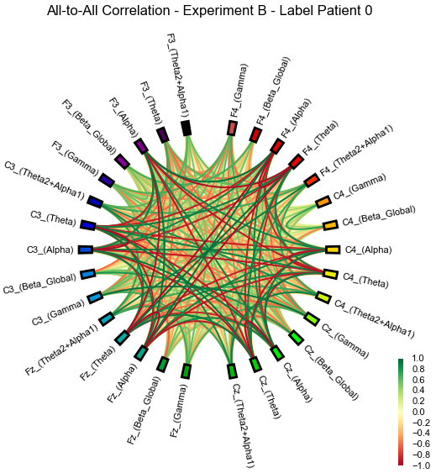
Pearson correlation graph

Slide 34
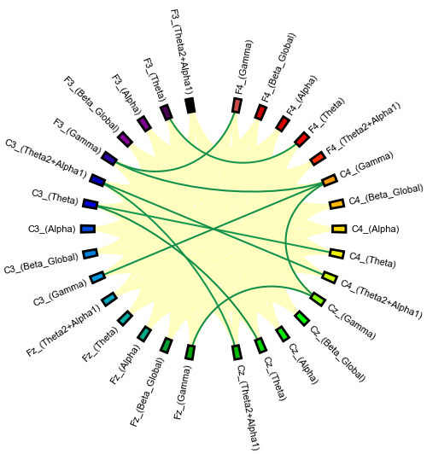
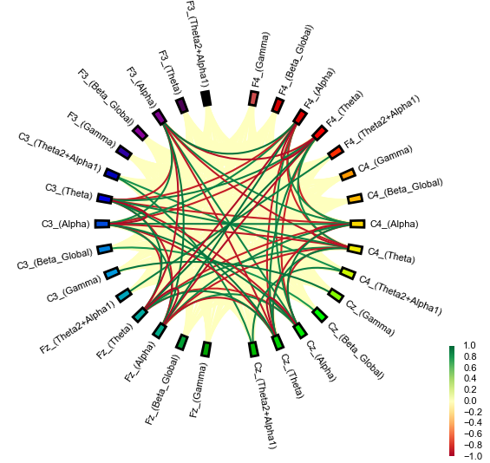
Pearson correlation graph – Finding Patterns (I)

Slide 35
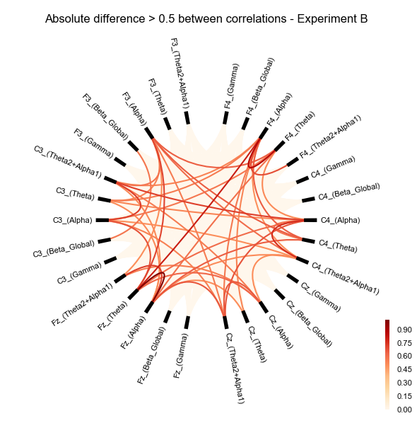
Pearson correlation graph – Finding Patterns (II)

Slide 36
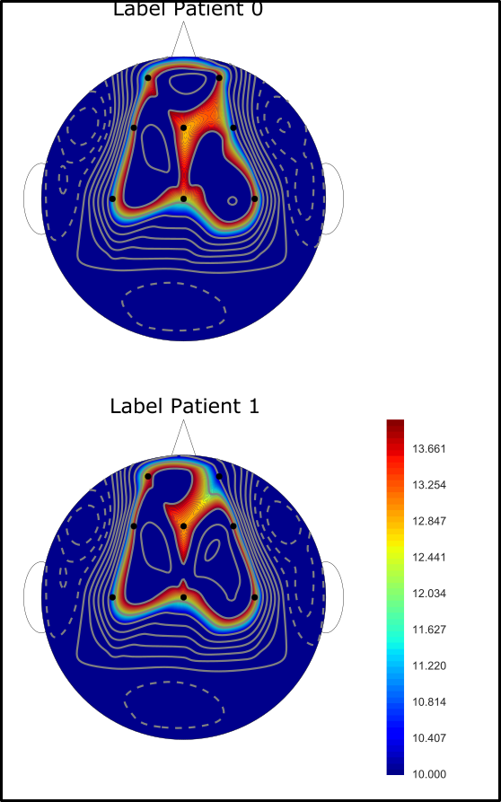
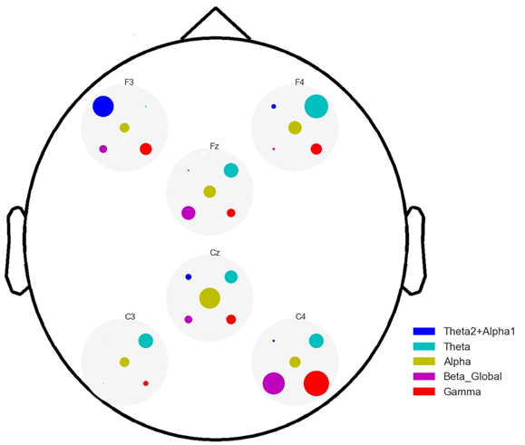
Connectivity correlation differences

Slide 37
Conclusions
2D visualization show A, C experiments analogous, B different→ discrimination between experiments B closed eyes, A attentional task, C, open eyes
We have performed several different clusterization methods to distinguish between healthy and ADHD subjects, and compared metrics and distributions. We have chosen the one with highest imbalance between classes.
Training of supervised learning models using labels from supervised classification has been performed as a case study.
Visualization of relative differences between healthy/ ADHD show that the more significative changes happen in the bands theta and beta and power ratio shows that the relevant electrodes are C4,Cz,C3 .
Pearson Correlation in Graphs show significant differences between healthy/ADHD
EEG signal characterization and subject classification achieved.

Slide 38
Project Resources
Repository Github : https://github.com/AdeuAndreu/ADHD_Project
Project Wiki: https://github.com/AdeuAndreu/ADHD_Project/wiki

Slide 39

Take-home Message

